Slide 1
Midterm 2 Exercise

Slide 2
PA Matching Point

Slide 3
Subsequence
S = abcabc T = abc
abcabc
abcabc
abcabc
abcabc

Slide 4
[Thought]
If the length of t is N, then we may need N times for-loop instinctively.
abcabc abc
[Problem]
The length of t isn’t fixed!!
=> Use recursion to solve
In main function, we call Match(0, 0)

Slide 5
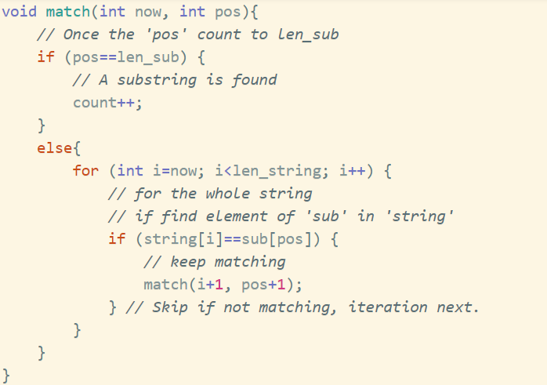

Slide 6
PB Transpose

Slide 7
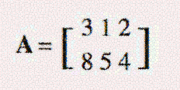
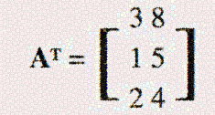
[Question]
Give a matrix and you need to transpose them.
[Concept]
If the matrix being transpose , just change the index of array and change the value in the array.

Slide 8
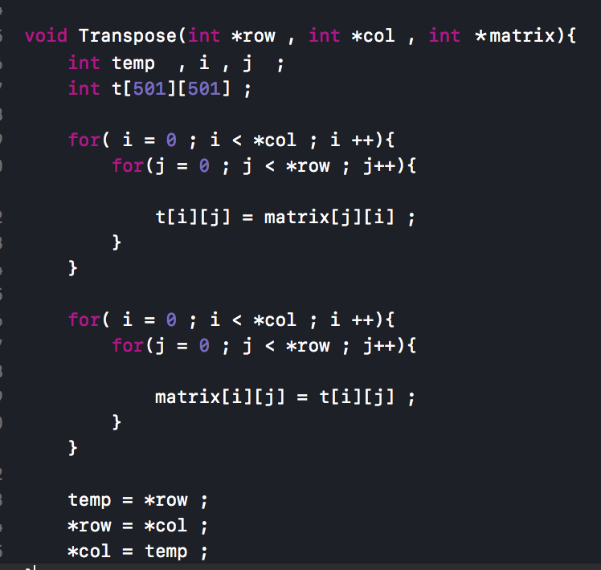

Slide 9
PC Ponds

Slide 10

[Thought]
Find every “~” (water) and ones nearby
Traverse every water on the map once
=> Mark the water(~) as “.” afterwards

Slide 11
~o~
~oo
oo~
~oo
oo~
ooo
Find the water in the map by iteration
Flip the water into land, search the water nearby and do 2nd step recursively

Slide 12
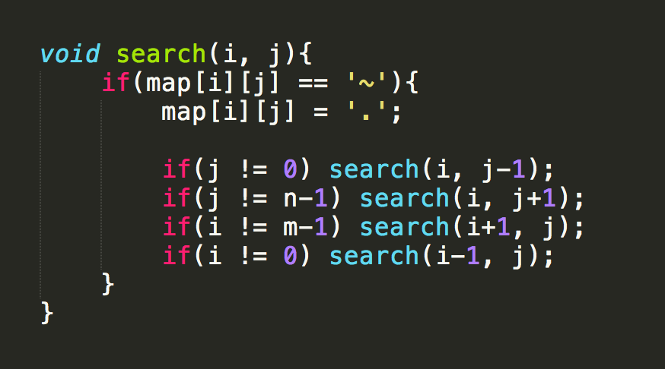

Slide 13
PD Fire!

Slide 14

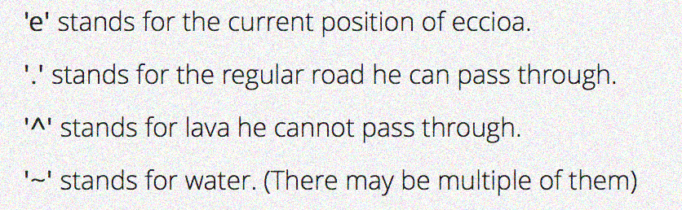
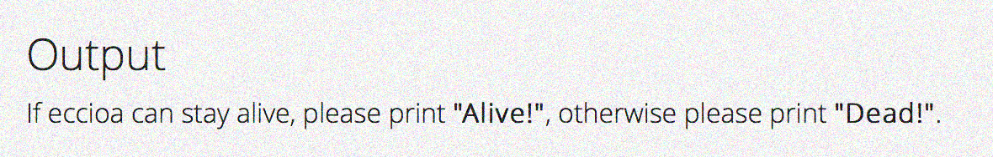

Slide 15
[Thought]
Find ”e” first
Find a path from “e” to ”~”, recursively visiting “.” around
How to determine if there isn’t?
=> Mark the road ”visited” once you’ve gone there

Slide 16
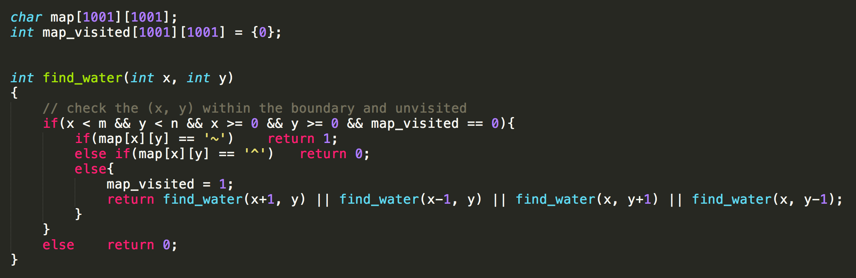

Slide 17
PE Shooting Star

Slide 18
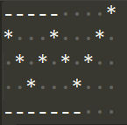
5 7 3
1
d

Slide 19
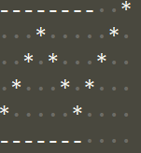
8 7 4
4
u

Slide 20
Thought
Loop
(For/While)
Recursion

Slide 21
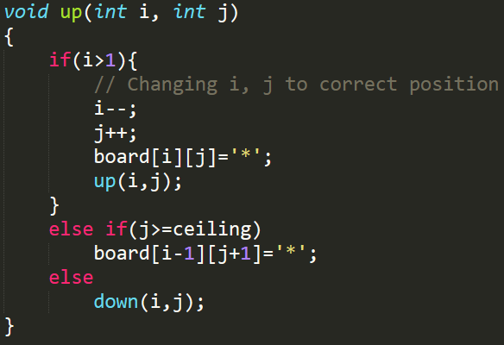
Recursive Way
You can implement down() by yourself

Slide 22
Boundary?
<Case 1> Ceiling
<Case 2> Floor
<Case 3> End of Shooting star

Slide 23
PF Prefix Notation

Slide 24
((5+2)*3)
*+523
*+523
*+523
*+523
*+523
*+523
END
5
+
7
*
2
3
21
Operator
Operand
Notes:
運算子(operator) 運算元(operand)

Slide 25
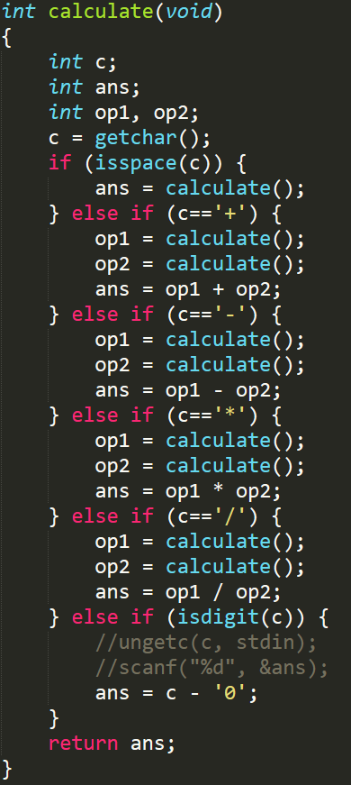

Slide 26
*+523=
op1 = Cal()
op2 = Cal()
ans = op1*op2
return ans
op1 = Cal()
op2 = Cal()
ans = op1+op2
return ans
5
Cal()
21
7
3
2
21
7

Slide 27
Thanks!
Any questions?

